Slide 1

Determination of the permittivity of thin layers in capacitors with different geometrical configurations using numerical methods
Student: Ștefan IȘFAN
SpecializATION: PHYSICAL COMPUTING
ACADEMIC YEAR: 3RD YEAR – BACHELOR’S DEGREE (2023-2024)
SCIENTIFIC COORDINATOR: LectURER dr. Leontin Pădurariu

Slide 2
Contents
⬤ Introduction
⬤ Known types of capacitors
⬤ The role of capacitors in evaluating electric permittivity
⬤ Motivation
⬤ Numerical approach
⬤ Results and interpretations
⬤ Conclusions

Slide 3
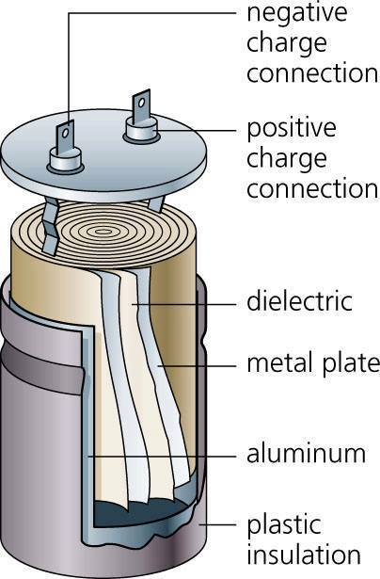
Capacitors
⬤ Capacitors store energy in the form of an electric field between two conductive plates separated by an insulator or dielectric.
⬤ The capacitance of a capacitor is measured in Farads and indicates the amount of electric charge stored for a given voltage.
⬤ When voltage is applied, electrons accumulate on one plate while the other plate exhibits an electron deficit, thereby creating an electric field.
⬤ The dielectric between the plates increases storage capacity and prevents direct charge transfer between the plates.
⬤ The stored electrical energy is released when the circuit is closed, allowing the charges to flow through an external circuit.

Slide 4
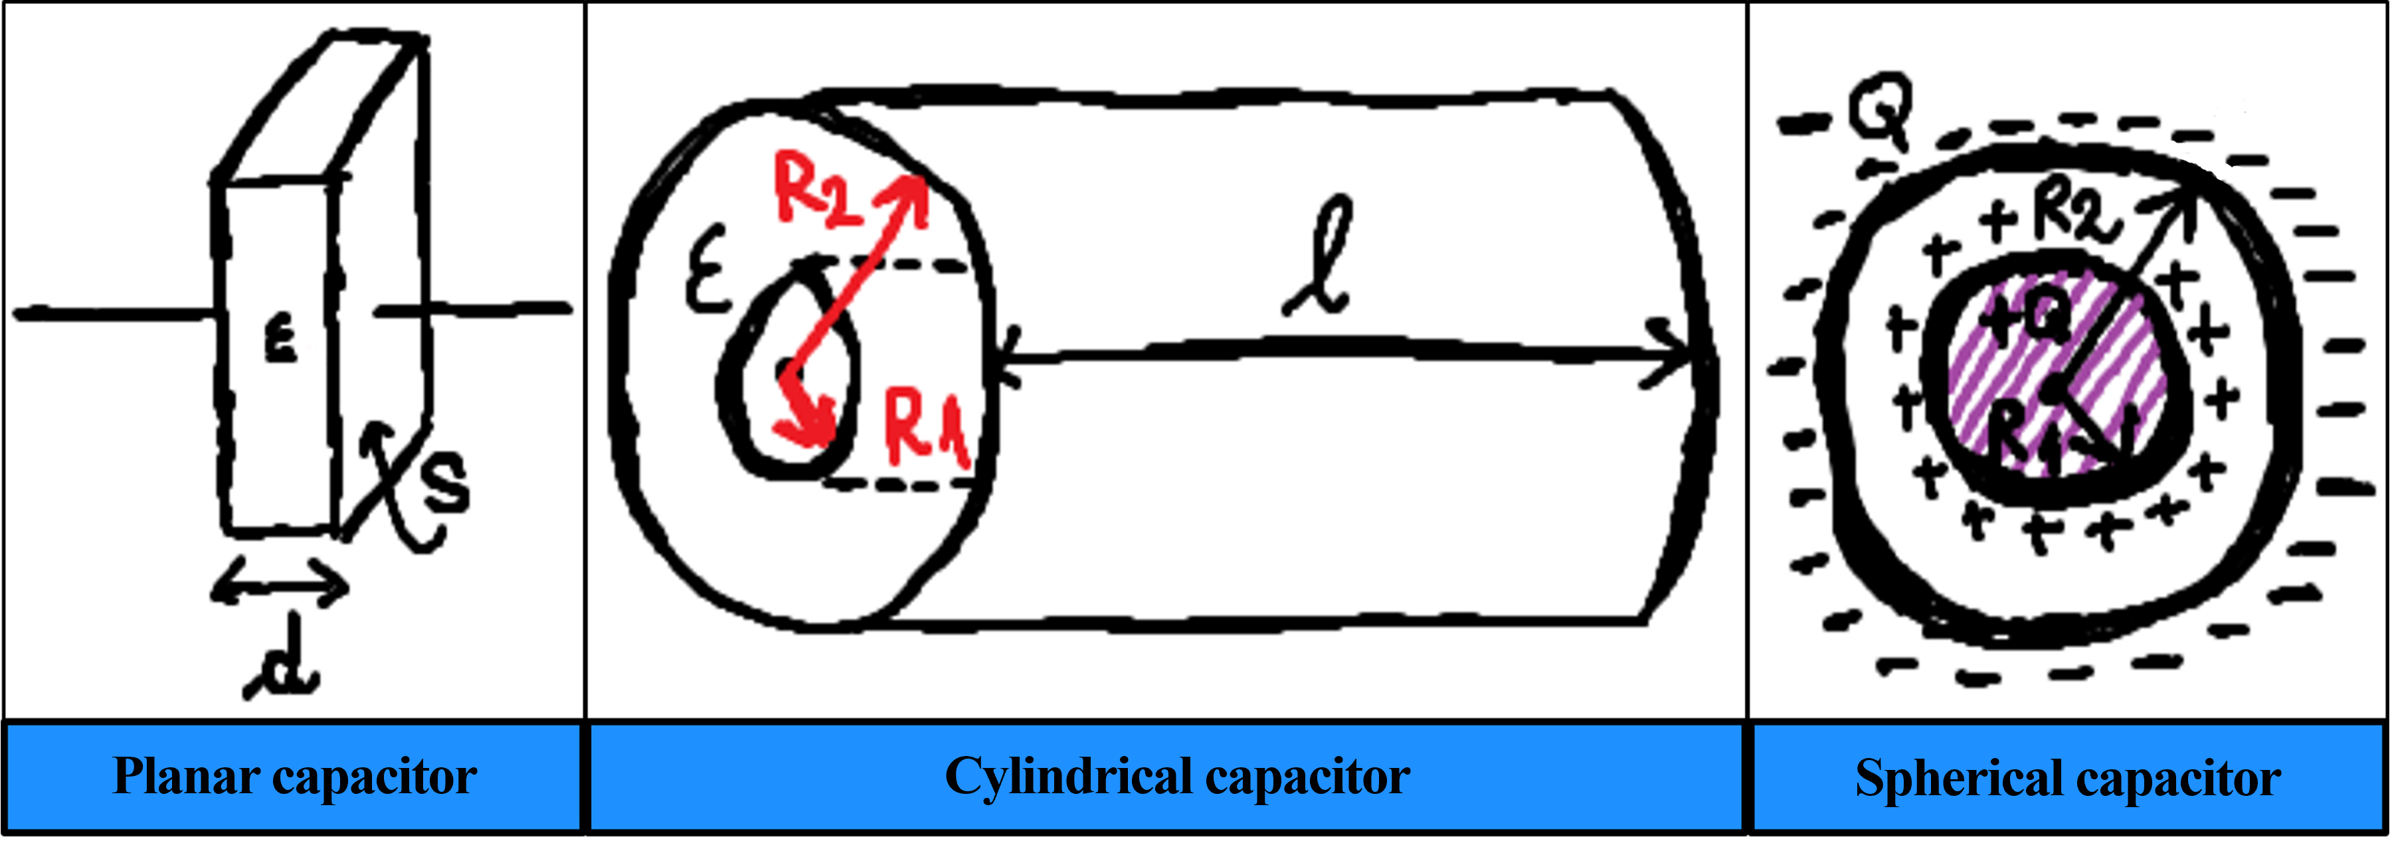
Known types of capacitors

Slide 5
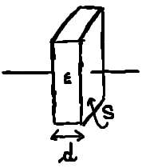
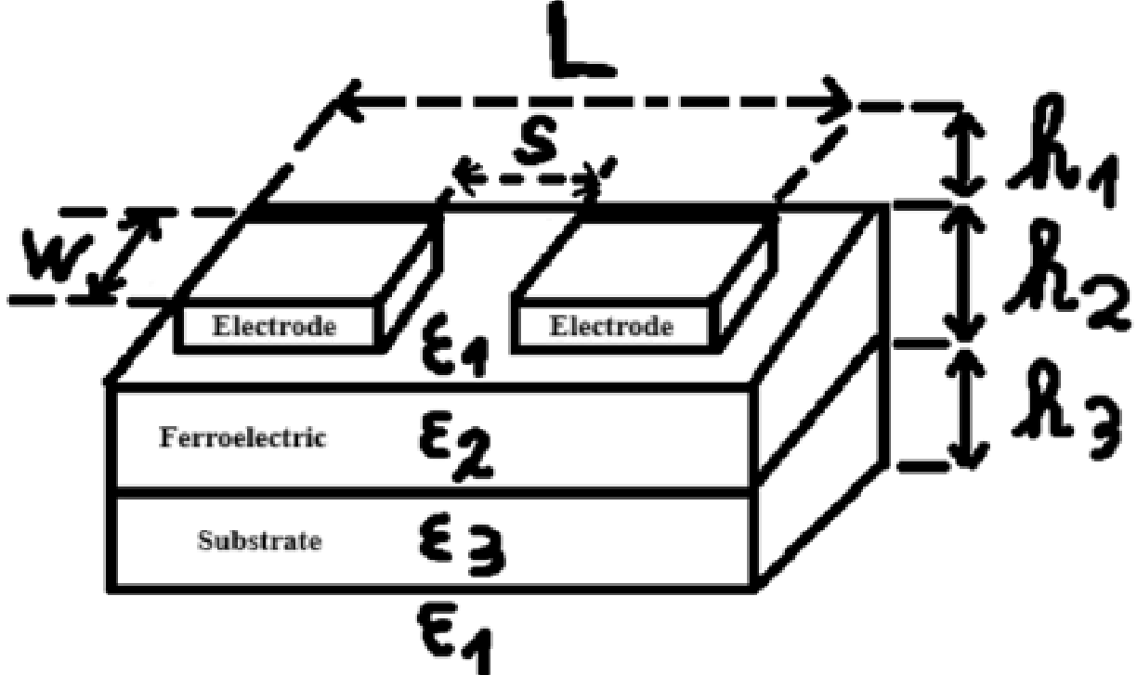
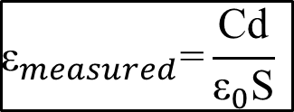
The role of capacitors in evaluating electric permittivity
A. Large-sized samples
B. Thin layers
$${\text{ε}}_{measured}\text{=}\frac{\text{Cd}}{{\text{ε}}_{0}\text{S}}$$
B. Malic, I. Boerasu, M. Mandeljc, M. Kosec, V. Sherman, T. Yamada, N. Setter si M. Vukadinovic, 2007 - Processing and dielectric characterization of Ba0.3Sr0.7TiO3 thin films on alumina substrates, Journal of the European Ceramic Society.

Slide 6
Motivation
⬤ There are configurations, such as those with coplanar electrodes, for which estimating capacitance analytically is very difficult.
⬤ The goal of this subject is to develop a numerical procedure based on the finite difference method capable of estimating the electrical capacitance of all types of capacitors.
⬤ The numerical procedure enables, for example, the understanding of how different geometric and electrical parameters affect the capacitance of coplanar electrode capacitors.
⬤ The insights gained from this numerical analysis are important for optimizing capacitors in various fields, from advanced electronics to efficient energy systems, with the potential to contribute to the advancement of future technologies.

Slide 7
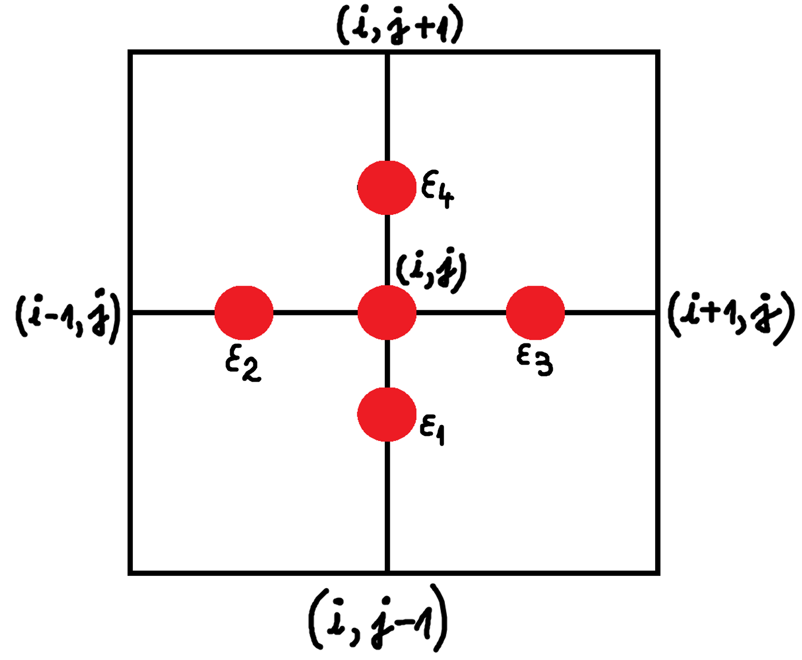
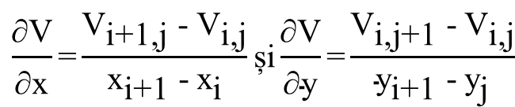
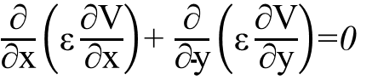
Numerical approach - Laplace equation with specific boundary conditions
⬤ The Laplace equation is important for determining electric fields and capacitance in capacitors. The domain of definition is discretized into a two-dimensional grid, where the calculation of partial derivatives is done numerically using finite differences.
$\frac{\text{∂}}{\text{∂}\text{x}}\left(\text{ε}\frac{\text{∂}\text{V}}{\text{∂}\text{x}}\right)$+ $\frac{\text{∂}}{\text{∂}\text{y}}\left(\text{ε}\frac{\text{∂}\text{V}}{\text{∂}\text{y}}\right)$=0
⬤ The partial derivatives at the point (xi, yj) are approximated by:
$$\frac{\text{∂}\text{V}}{\text{∂}\text{x}}\text{=}\frac{{\text{V}}_{\text{i}\text{+}\text{1}\text{,}\text{j} }\text{−} {\text{V}}_{\text{i}\text{,}\text{j}}}{{\text{x}}_{\text{i}\text{+}\text{1} }\text{−}{ \text{x}}_{\text{i}}}\text{ș}\text{i}\frac{\text{∂}\text{V}}{\text{∂}\text{y}}\text{=}\frac{{\text{V}}_{\text{i}\text{,}\text{j}\text{+}\text{1} }\text{−}{ \text{V}}_{\text{i}\text{,}\text{j}}}{{\text{y}}_{\text{i}\text{+}\text{1} }\text{−}{ \text{y}}_{\text{j}}}$$
⬤ The discretized Laplace equation is
$$\frac{ε_{1}}{h_{y}^{2}}V_{i,j−1}+\frac{ε_{2}}{h_{x}^{2}}V_{i−1,j}+\frac{ε_{3}}{h_{x}^{2}}V_{i+1,j}+\frac{ε_{4}}{h_{y}^{2}}V_{i,j+1}−\left(\frac{ε_{1}}{h_{y}^{2}}+\frac{ε_{2}}{h_{x}^{2}}+\frac{ε_{3}}{h_{x}^{2}}+\frac{ε_{4}}{h_{y}^{2}}\right)V_{i,j}=0$$
where h_{x} si h_{y} are the discretization steps along the Ox și Oy axes.

Slide 8
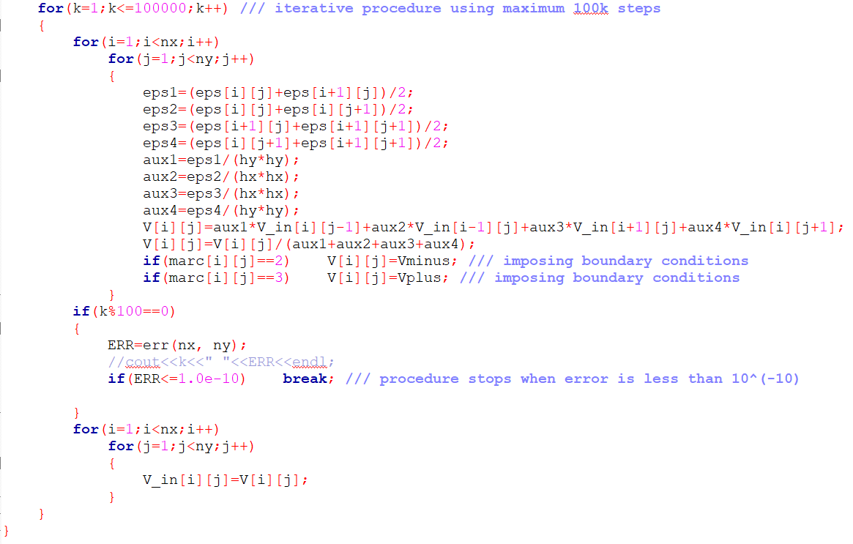
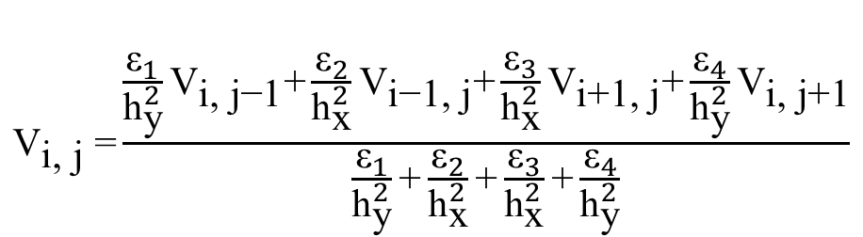
Numerical approach - Laplace equation with specific boundary conditions
$${\text{V}}_{\text{i}\text{, }\text{j} }\text{=}\frac{\frac{{\text{ε}}_{1}}{{\text{h}}_{\text{y}}^{2}}{\text{V}}_{\text{i}\text{, }\text{j}\text{−}\text{1}}\text{+}\frac{{\text{ε}}_{2}}{{\text{h}}_{\text{x}}^{2}}{\text{V}}_{\text{i}\text{−}\text{1}\text{, }\text{j}}\text{+}\frac{{\text{ε}}_{3}}{{\text{h}}_{\text{x}}^{2}}{\text{V}}_{\text{i}\text{+}\text{1}\text{, }\text{j}}\text{+}\frac{{\text{ε}}_{4}}{{\text{h}}_{\text{y}}^{2}}{\text{V}}_{\text{i}\text{, }\text{j}\text{+}\text{1}}}{\frac{{\text{ε}}_{1}}{{\text{h}}_{\text{y}}^{2}}\text{+}\frac{{\text{ε}}_{2}}{{\text{h}}_{\text{x}}^{2}}\text{+}\frac{{\text{ε}}_{3}}{{\text{h}}_{\text{x}}^{2}}\text{+}\frac{{\text{ε}}_{4}}{{\text{h}}_{\text{y}}^{2}}}$$

Slide 9
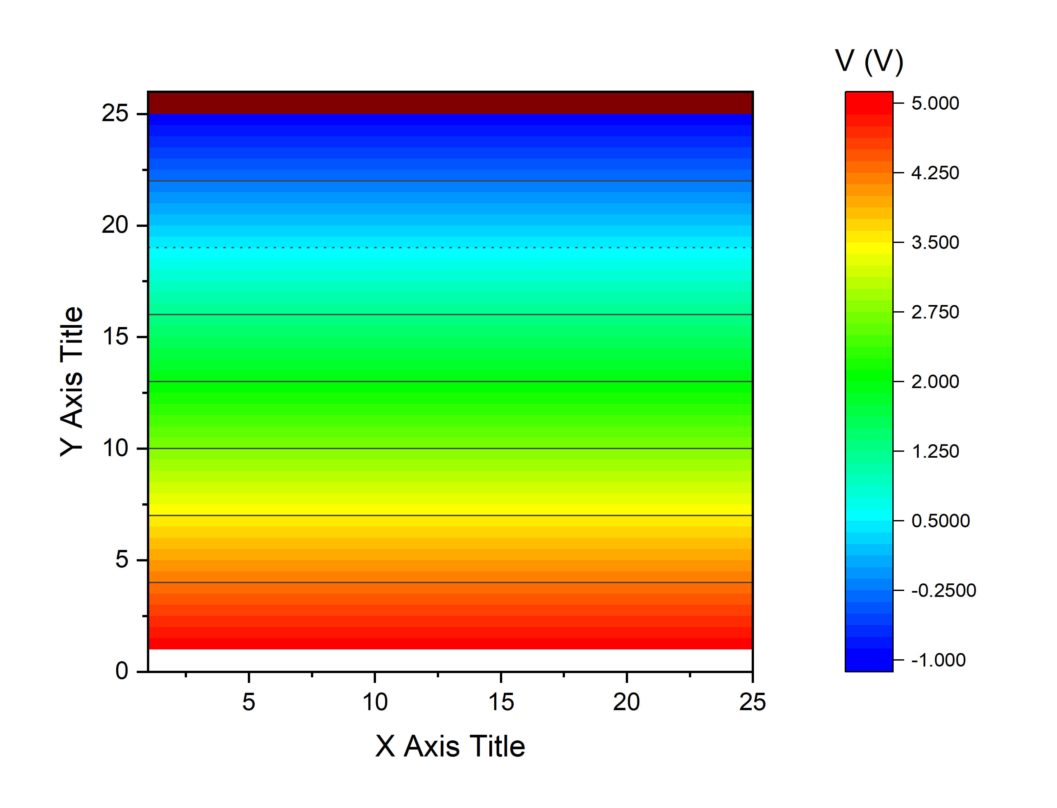
Numerical approach - Laplace equation with specific boundary conditions
Potential distribution as a function of the applied voltage for a parallel-plate capacitor with periodic boundary conditions
⬤ The presented graph demonstrates how the electric potential varies linearly inside a planar capacitor in response to an applied voltage. This linear relationship is characteristic of a uniform dielectric medium and the absence of edge effects.
⬤ Under the influence of an applied voltage, the capacitor generates a uniform electric field, so the potential varies linearly from one plate to the other. This distribution is described by Laplace’s equation for a homogeneous medium without free charges.

Slide 10
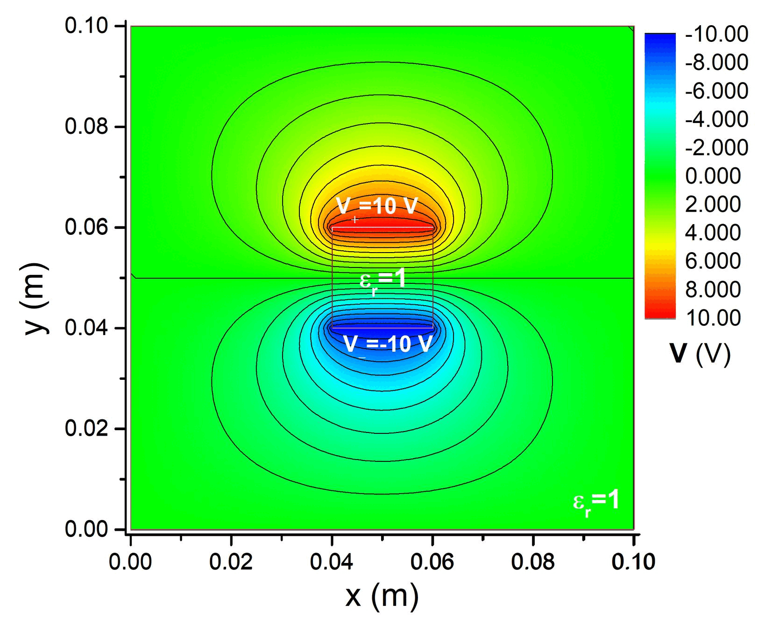
Results and interpretations
A. Parallel-plate capacitor
⬤ The image shows the influence of the dielectric on the field in the capacitor.

Slide 11

Results and interpretations
A. Parallel-plate capacitor
⬤ The image shows the influence of the distance between the electrodes on the field in the capacitor.

Slide 12
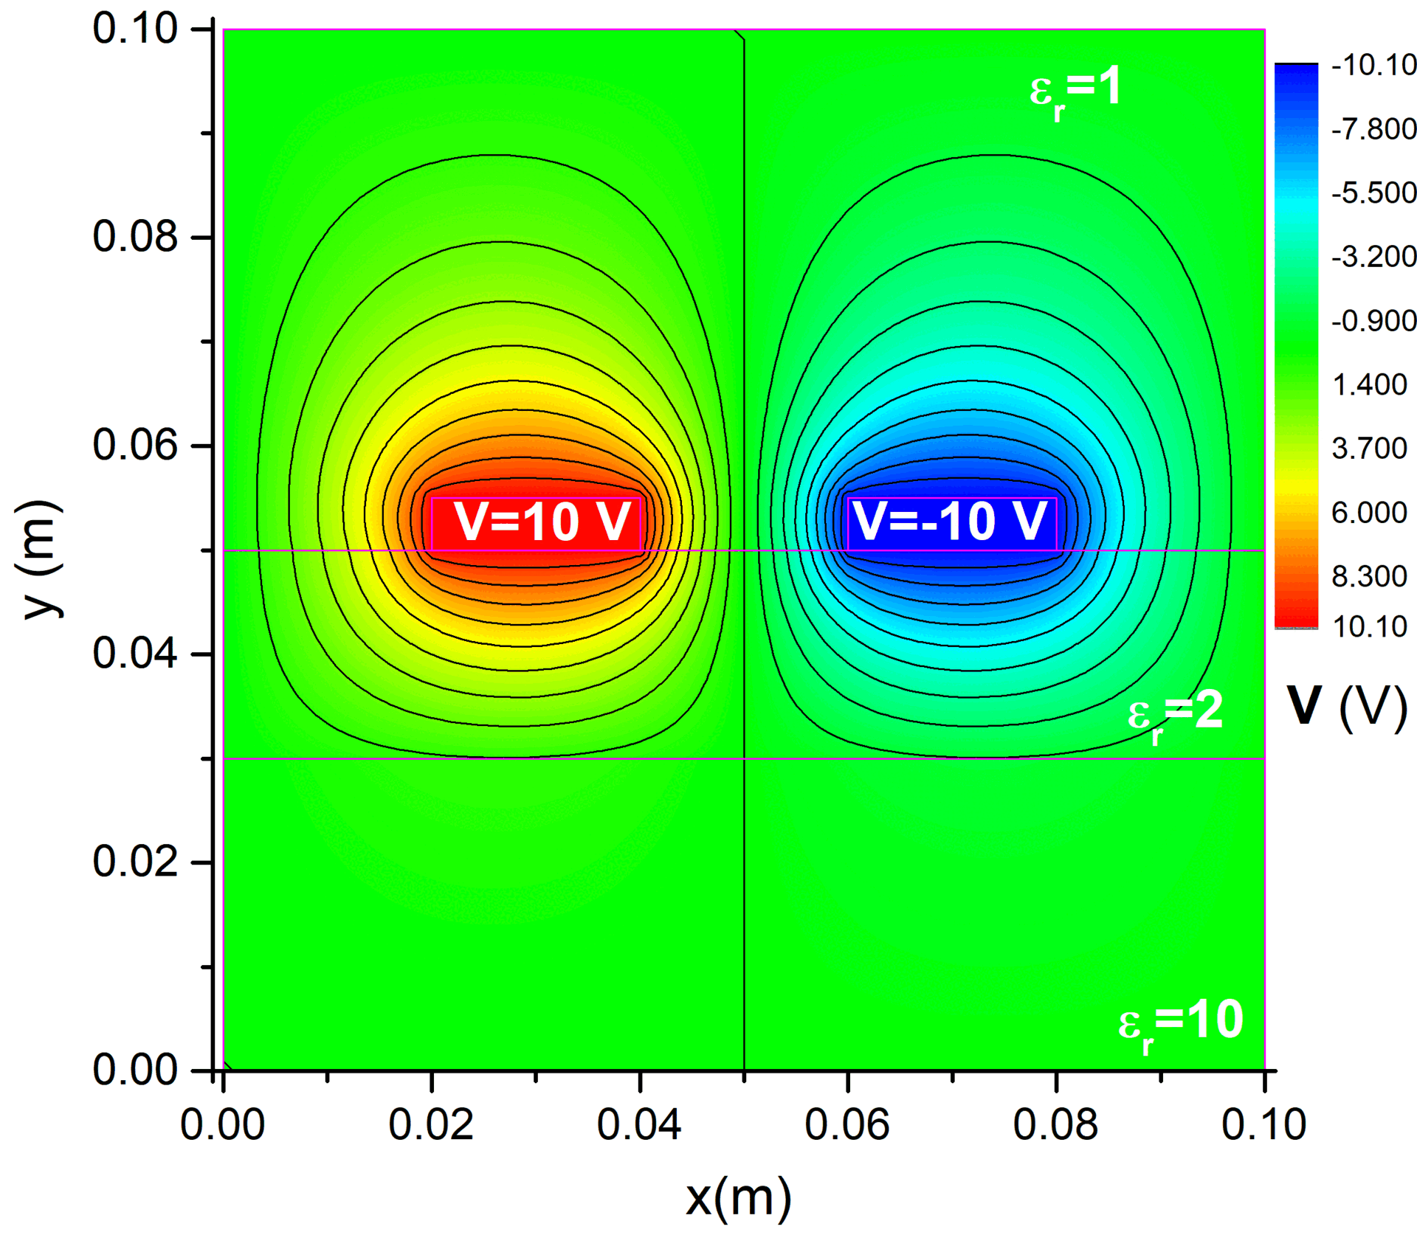
Results and interpretations
B. Coplanar electrode capacitor
⬤ The image shows the distribution of the electric potential in a thin-film capacitor.

Slide 13
Conclusions
⬤ The finite difference method confirms the direct relationship between capacitor capacitance and dielectric permittivity characteristics depending on their geometric configuration.
⬤ The results highlight the importance of edge effects in evaluating dielectric permittivity and how these can be quantified using numerical techniques.
⬤ The analysis of capacitance in relation to the permittivity of a thin layer opens new opportunities for advanced experimental investigations of thin dielectric films.

